Slide 1
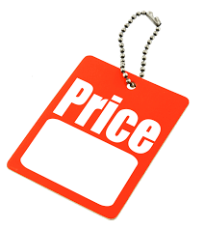
PRICE CONTROLLER Presented by Prefna and Ewurafua

Slide 2

OVERVIEW
What is Price Controller
Purpose of the website
Application
Competitive advantage
Creative Process

Slide 3

PRICE CONTROLLER
People usually struggle about where to get their goods at the most affordable prices.
That's why we want to introduce you with Price Controller, a website that will track prices of good and services in terms of:
Old and new prices of commodities,
Identify stores or businesses that provide goods and services that are not extremely inflated. To help people choose which market or store they will go to, in order to get whatever it is they want at affordable prices instead of going somewhere and being astonished by the price of a particular product, and having no choice but to purchase it because they do not know if the price elsewhere is better or worse .
Therefore, our website will compare the different prices of a certain commodity on different (online) stores.

Slide 4

PURPOSE OF WEBSITE
Displaying the affordable prices of commodities.
Displaying the average price of commodities so it makes sense to the buyers whenever they find themselves buying those goods.
Showing locations/ online shopping in Accra that sell items at reasonable prices.
Updating new and old prices of commodities, to track the change in prices

Slide 5

APPPLICATION
To enable people to know where to get the best selling prices on the market.
Retailers and suppliers will be able to compare the prices of a certain commodity in order to apply that price with their own goods. This will allow them to sell goods at reasonable prices and will reduce inflation.
Customers will have a comment session to share their experiences.
Policies makers will be informed about what people experience with our comment session.

Slide 6

OUR COMPETITIVE ADVANTAGE
Our website will compare prices of goods and services.
Will predict prices, based on the devaluation of money, rules and regulations, the dollar rate and so on.
Enable customers to puchase good at affordable prices by comparing the prices of a specific good in different stores.

Slide 7
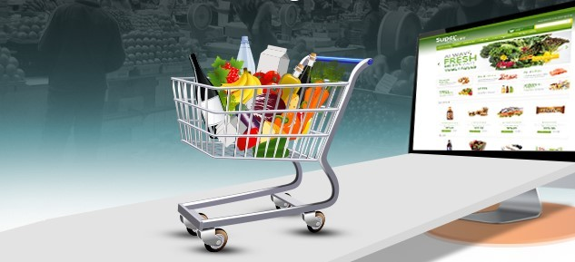
CREATIVITY
CUSTOMER CARE: A comment section will be available for people to drop their experiences, this will enable the citizens and the government agencies to be informed about shops or companies who abnormally increase their itemizes and those whose prices are reasonable.
ONLINE SHOPPING: Various itemizes will be displayed on our website with their prices and detailed information about the products.
FIXED DELIVERY SERVICES: Moderate delivery prices or free.
To partner with all the Policy Makers in the long run, so to have PRICING CONTROL POLICE OFFICERS who will be employed to check price inflations in the country, based on the experiences people will share on our webpage.

